Slide 1






PES’s Modern College of Engineering, Shivajinagar, Pune-5.
Department of Electronics and Telecommunication
2024-25
Chronic Kidney Disease Detection
And Guidance
Names of the student
1. Vedant Dindore
2. Anurag Ganvir
3. Varad Gondkar
Guided By : Dr. Prof. Mrs. Deepali Adhyapak

Slide 2



PES’s Modern College of Engineering, Shivajinagar, pune-5.
Department of Electronics and Telecommunication
Overview :
Introduction
Literature Survey (Market, Literature, Technological and Research Survey)
System Specifications
Block Diagram
Hardware Design
Software Design
Results (Photo / Audio-Visual / Video Results)
Applications
Future Scope
Conclusion
References

Slide 3
PES’s Modern College of Engineering, Shivajinagar, pune-5.
Department of Electronics and Telecommunication
Introduction :
Chronic Kidney Disease (CKD): A progressive loss of kidney function, early detection is key for better outcomes.
Role of Machine Learning: ML analyzes medical data to find patterns and develop predictive models for CKD.
Project Objectives: Build an efficient ML model to accurately detect CKD and improve early diagnosis.

Slide 4
PES’s Modern College of Engineering, Shivajinagar, pune-5.
Department of Electronics and Telecommunication
Literature Survey :
1. Market Analysis :
Prevalence and Impact of CKD:
Economic burden: healthcare costs, loss of productivity, and overall impact on public health.
Market Demand for CKD Detection Solutions:
Growing demand for early diagnosis and management tools in nephrology.
Increased focus on preventive healthcare and personalized medicine.
Emerging Trends:
Integration of ML and AI in healthcare practices.
Collaboration between tech companies and healthcare providers to enhance CKD management.

Slide 5
PES’s Modern College of Engineering, Shivajinagar, pune-5.
Department of Electronics and Telecommunication
Literature Survey :
1. Literature Review :
Previous Studies on CKD Detection:
Focusing on traditional diagnostic methods vs ML approach.
Summary of various algorithms which can be used.
Gaps in Current Research:
Limitations of existing models, such as data diversity, feature selection, and generalizability across different populations.
Need for larger datasets and real-world validation of machine learning models.

Slide 6
PES’s Modern College of Engineering, Shivajinagar, pune-5.
Department of Electronics and Telecommunication
Literature Survey :
1. Literature Review :
Regulatory and Ethical Considerations:
Overview of regulatory guidelines for implementing machine learning in clinical settings.
Ethical concerns related to data privacy, bias, and the need for transparency in AI-driven healthcare solutions.

Slide 7
PES’s Modern College of Engineering, Shivajinagar, pune-5.
Department of Electronics and Telecommunication
Literature Survey :
1. Technological Survey :
Machine Learning Techniques :
Using Algorithms like Random Forest, Decision Trees, Neural Networks.
Data Sources and Tools :
Decision testing as verified datasets from Kaggle. Open Source data from US Centre for Control Disease and Prevention (US CDC).
Current Technology Trends:
Advancements in data analytics, cloud computing, and AI that facilitate the development of robust CKD detection models.

Slide 8
PES’s Modern College of Engineering, Shivajinagar, pune-5.
Department of Electronics and Telecommunication
Literature Survey :
1. Research Survey :
Current Research Initiatives:
Using Machine Learning in detection of anomalies and differences from the normal data.
Future Research Directions:
Building more robust model for fast execution
and result generation of multiple patients.
Community and Stakeholder Engagement:
Patients, healthcare providers, and policymakers in research efforts to ensure models meet real- world needs.

Slide 9
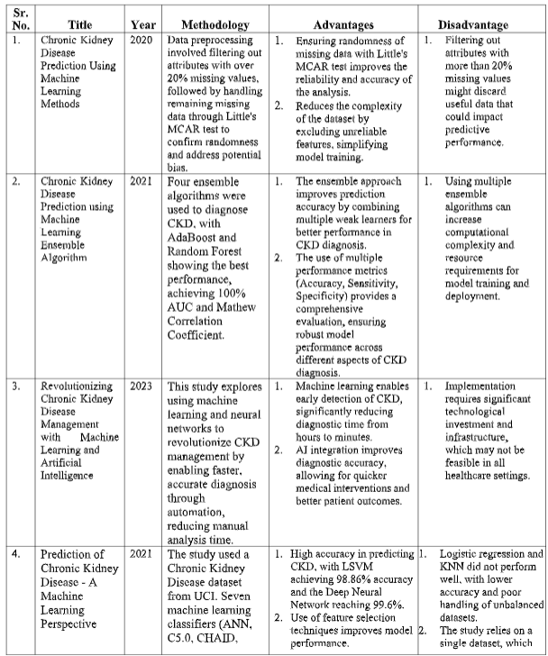
PES’s Modern College of Engineering, Shivajinagar, pune-5.
Department of Electronics and Telecommunication
Literature Survey :
1. Research Survey :

Slide 10
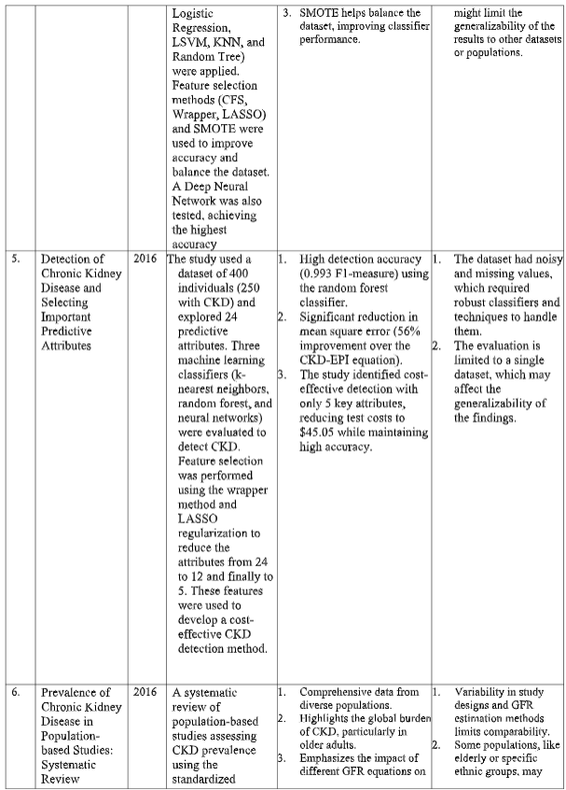
PES’s Modern College of Engineering, Shivajinagar, pune-5.
Department of Electronics and Telecommunication
Literature Survey :
1. Research Survey :

Slide 11
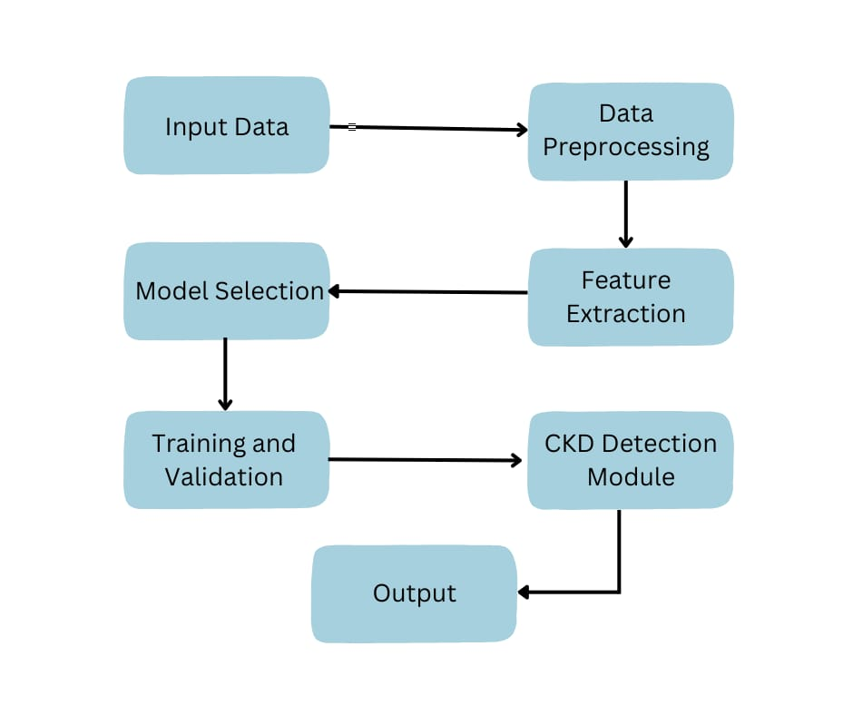
PES’s Modern College of Engineering, Shivajinagar, pune-5.
Department of Electronics and Telecommunication
System Specifications :
Block Diagram:

Slide 12
PES’s Modern College of Engineering, Shivajinagar, pune-5.
Department of Electronics and Telecommunication
System Specifications :
1. Hardware Components:
Arduino Microcontroller.
LCD Display (16x2 or 20x4).
Wi-Fi Module (e.g., ESP8266 or ESP32).
Power Supply.
2. Software Components
AWS Cloud Platform.
Python (major) and CPP (for small robust application)
Communication Protocol : REST API.
Matlplotlib, Pyplot, Seaborn (for visualizing data)
Sklearn (for imputations), Decision Tree, Random Forest.

Slide 13
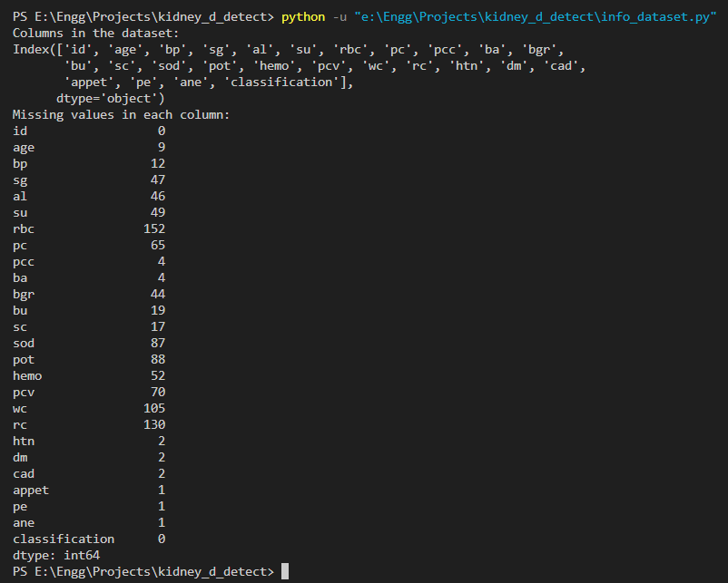
PES’s Modern College of Engineering, Shivajinagar, pune-5.
Department of Electronics and Telecommunication
Results :

Slide 14
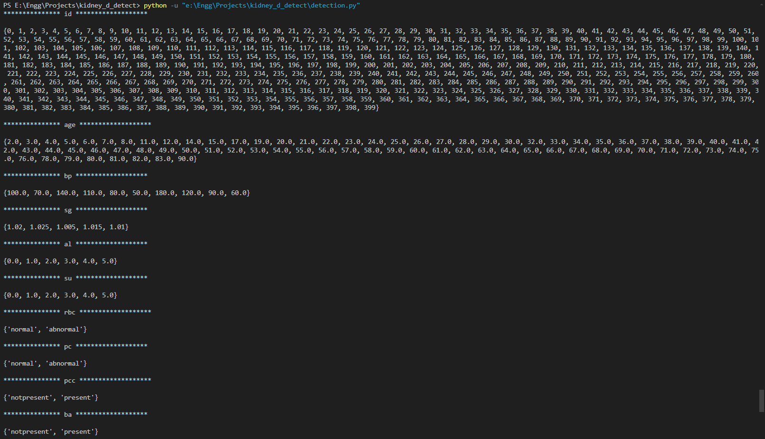
PES’s Modern College of Engineering, Shivajinagar, pune-5.
Department of Electronics and Telecommunication
Results :

Slide 15
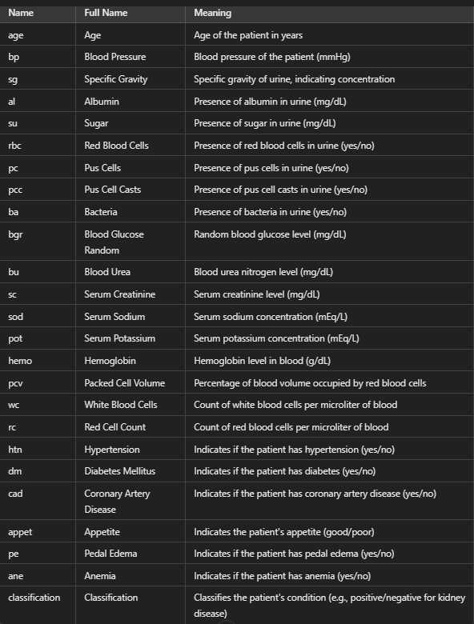
PES’s Modern College of Engineering, Shivajinagar, pune-5.
Department of Electronics and Telecommunication
Terminologies :

Slide 16
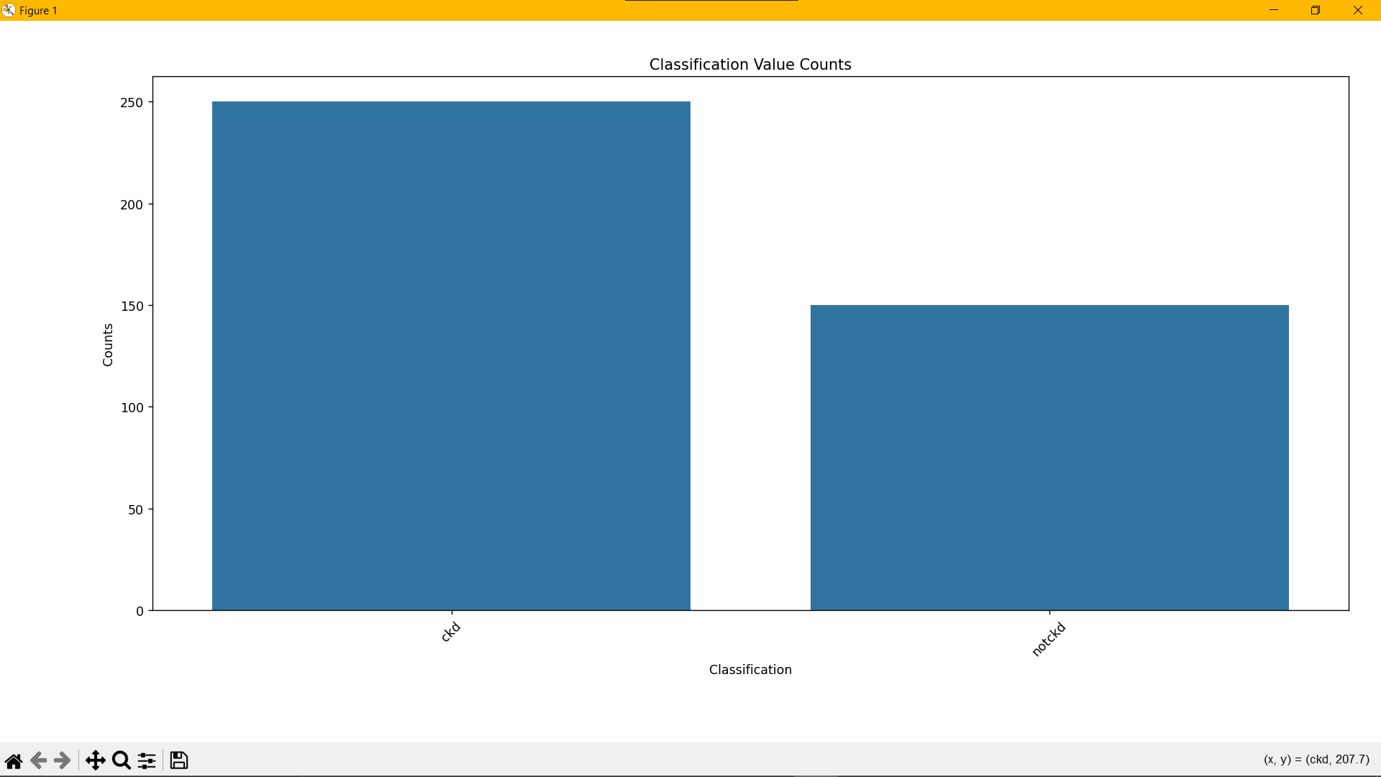
PES’s Modern College of Engineering, Shivajinagar, pune-5.
Department of Electronics and Telecommunication
Results :

Slide 17
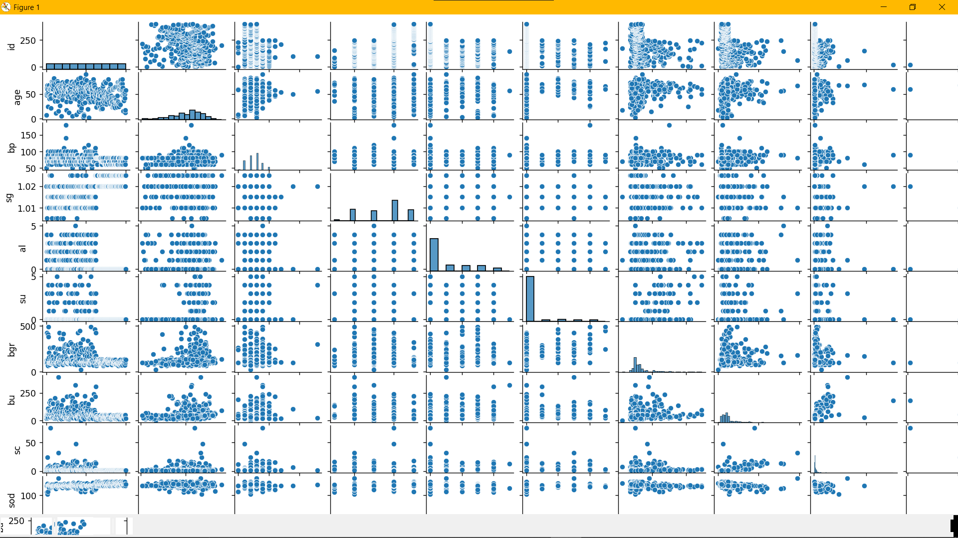
PES’s Modern College of Engineering, Shivajinagar, pune-5.
Department of Electronics and Telecommunication
Results :

Slide 18
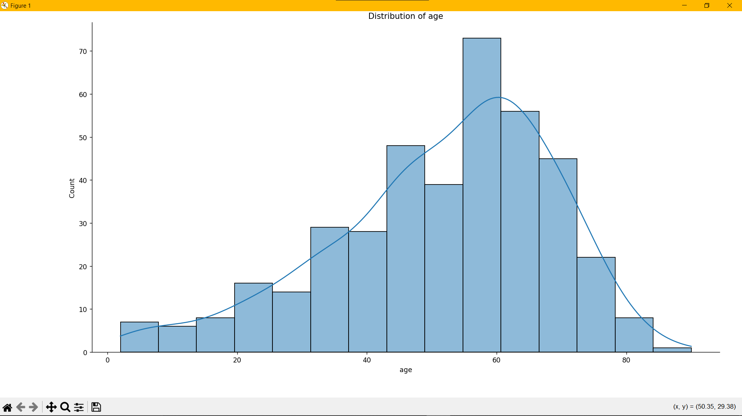
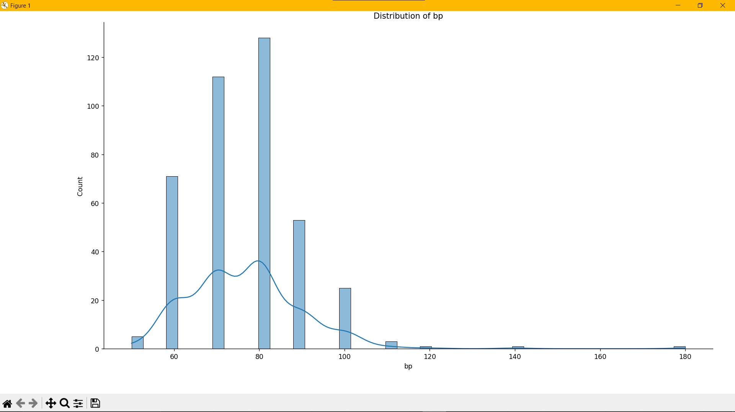
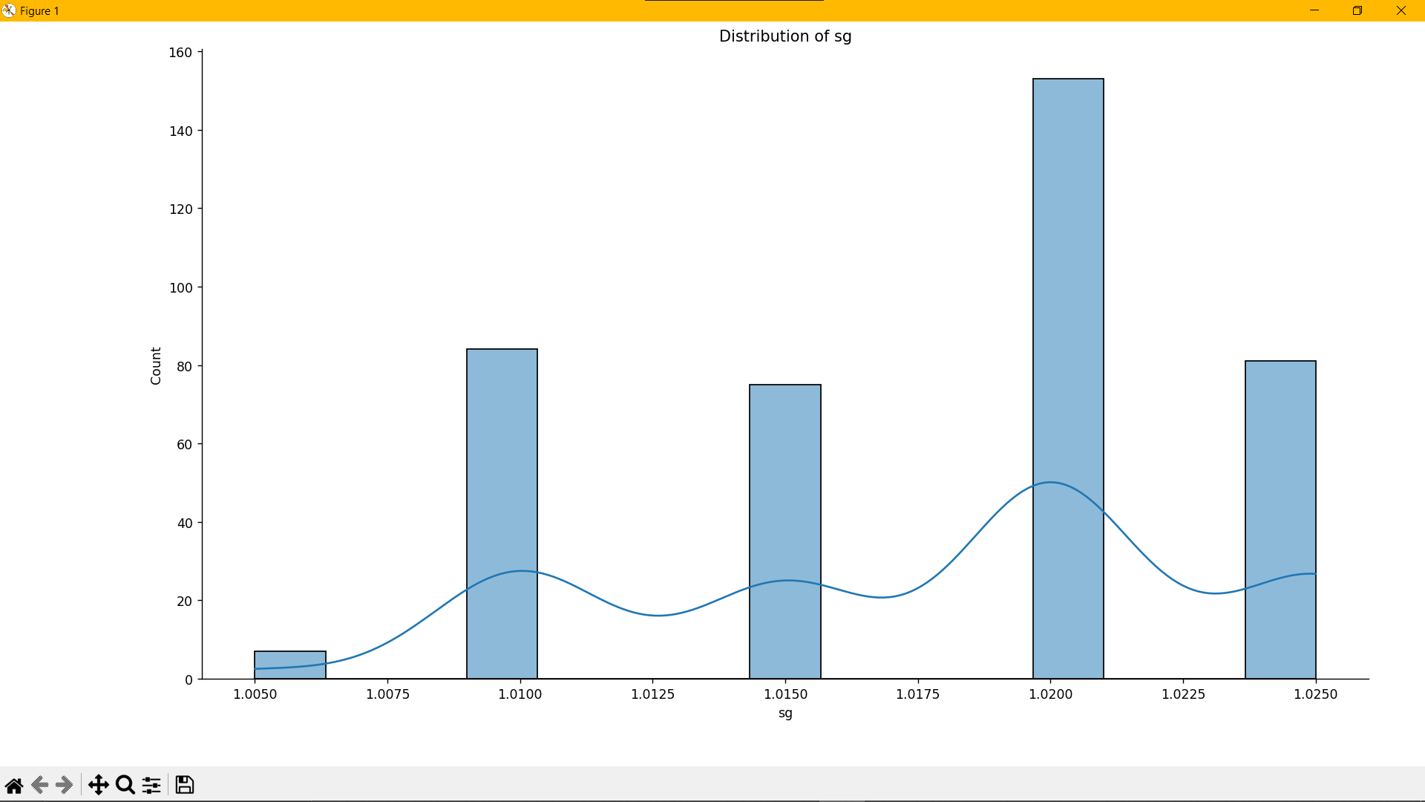
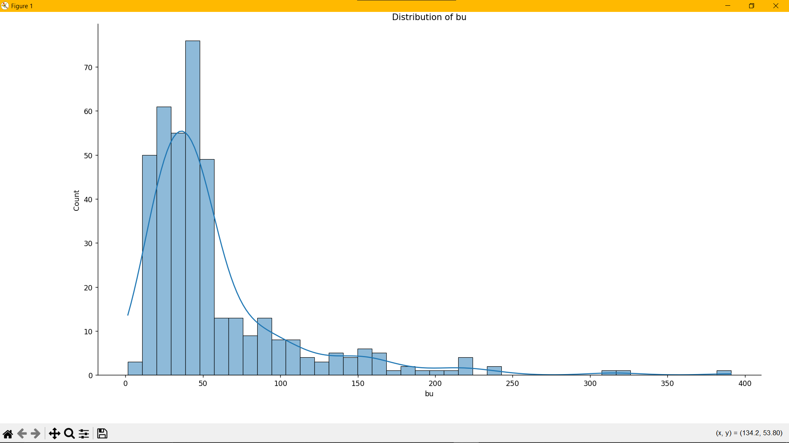
PES’s Modern College of Engineering, Shivajinagar, pune-5.
Department of Electronics and Telecommunication
Results :

Slide 19
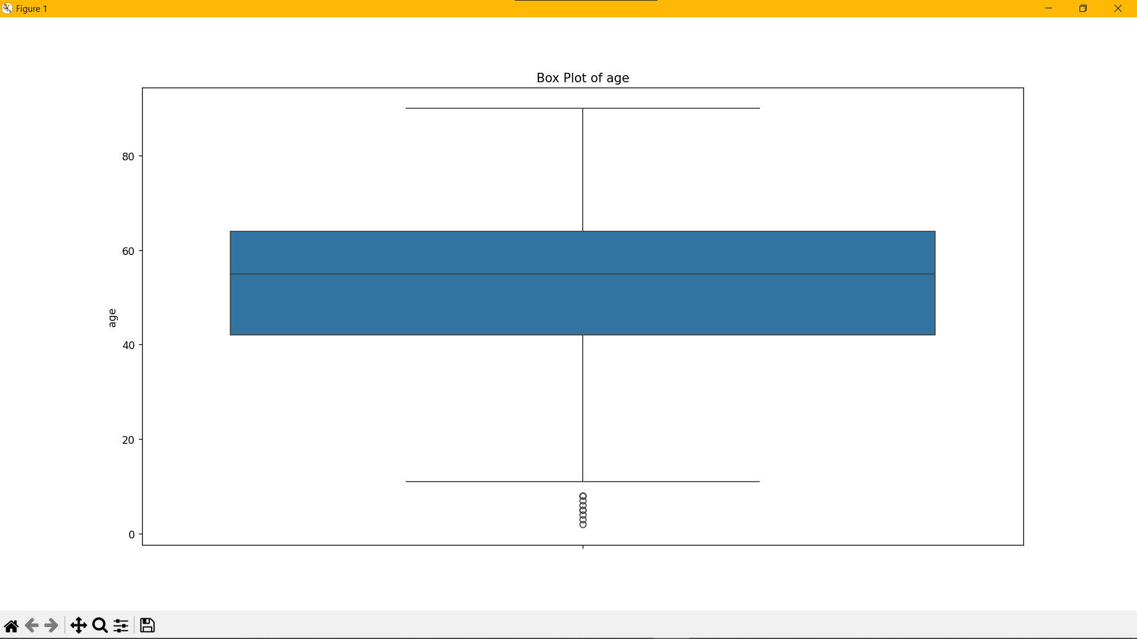
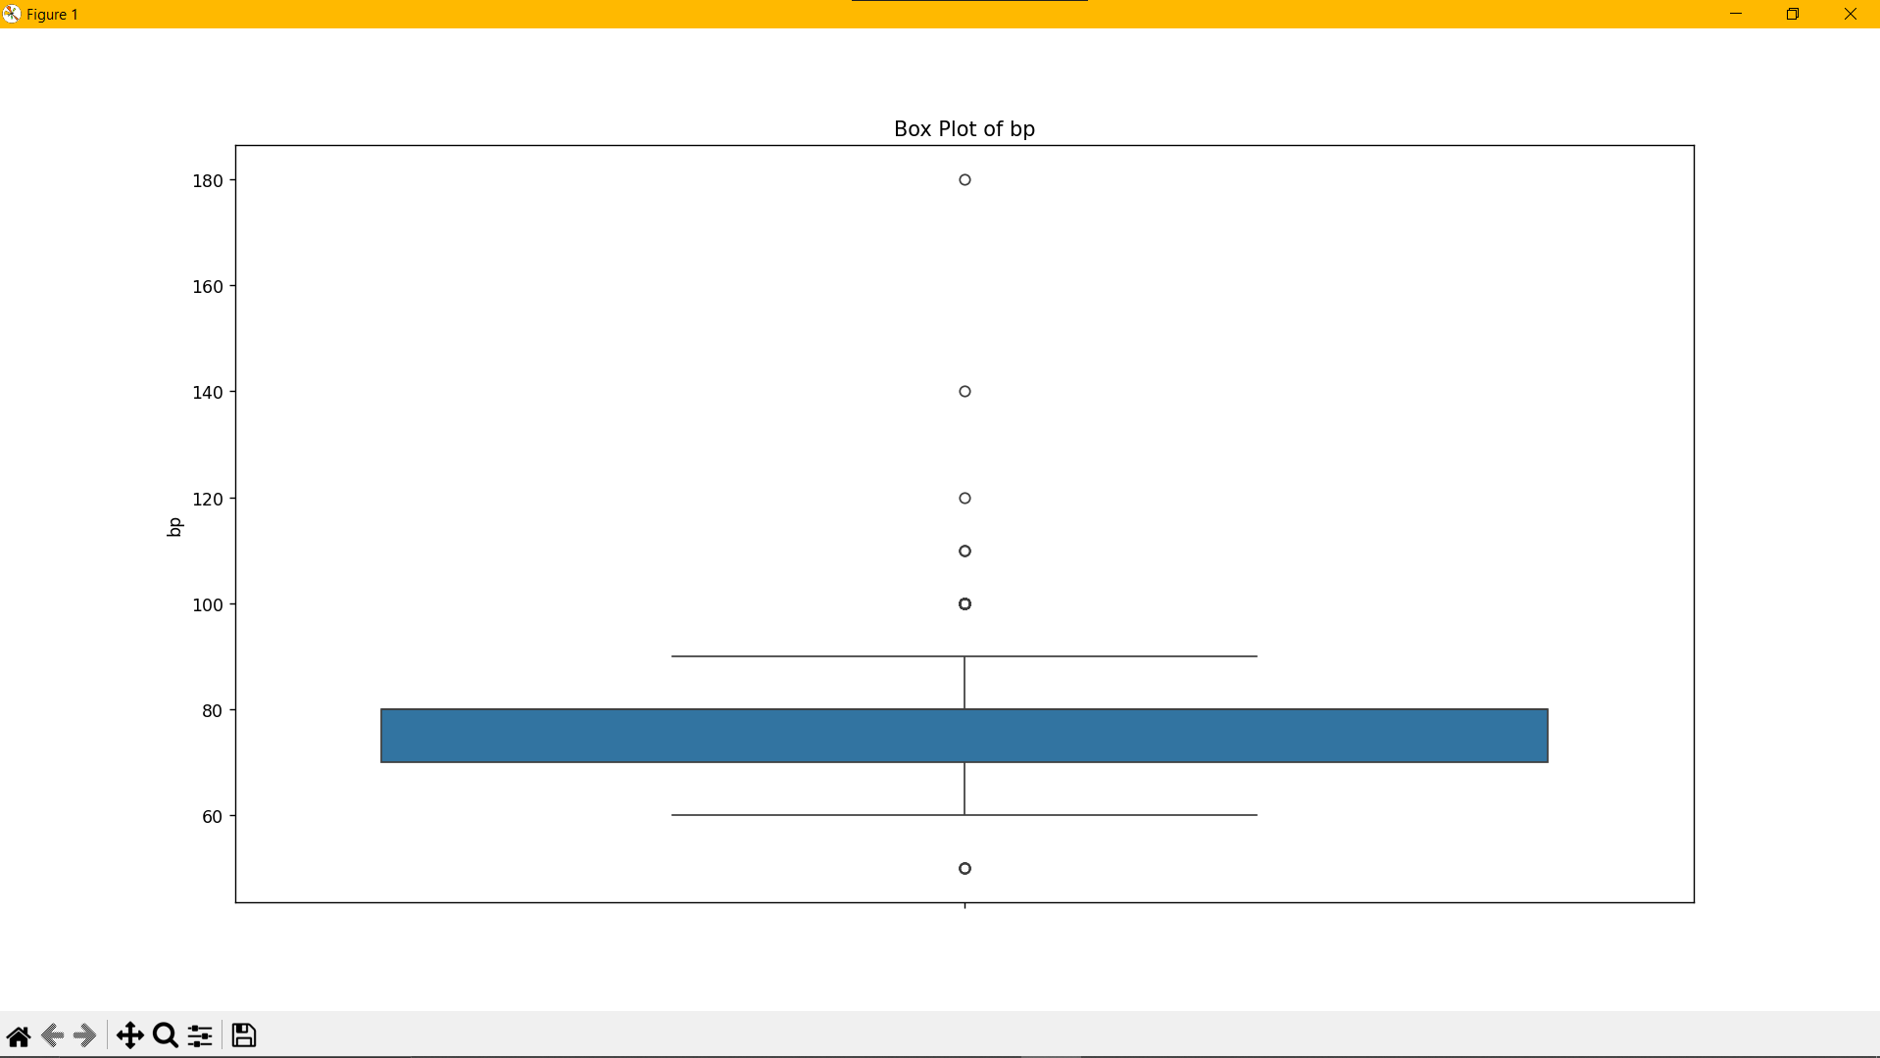
PES’s Modern College of Engineering, Shivajinagar, pune-5.
Department of Electronics and Telecommunication
Results :

Slide 20
PES’s Modern College of Engineering, Shivajinagar, pune-5.
Department of Electronics and Telecommunication
Applications:
Early Diagnosis in Healthcare.
Remote Patient Monitoring.
Personalized Treatment Plans.
Real-Time Alerts for Patients.
Integration with Wearable Technology.
Data-Driven Decision Making.
Cost-Effective Screening.
Support for Telemedicine.
Reducing time by 72.3%.

Slide 21
PES’s Modern College of Engineering, Shivajinagar, pune-5.
Department of Electronics and Telecommunication
Future Scope :
Improvement in Prediction Accuracy.
AI-Based Decision Support System.
Scalability for Global Improvement.
Advanced Iot & Wearable Integration.
Regulatory Approval & Clinical Integration.
Enhancing Computing Power.
Patient Centric Health Platforms.

Slide 22
PES’s Modern College of Engineering, Shivajinagar, pune-5.
Department of Electronics and Telecommunication
Conclusion :
This CKD detection system using machine learning combines real-time monitoring with cloud-based analysis to provide an efficient and cost-effective solution for early diagnosis. By leveraging hardware like Arduino and AWS’s cloud services, it enhances healthcare outcomes. With future improvements in accuracy and scalability, it has the potential to revolutionize CKD management, especially in remote and underserved areas.

Slide 23
PES’s Modern College of Engineering, Shivajinagar, pune-5.
Department of Electronics and Telecommunication
References:
[1] Imesh Udara Ekanayake, et al., &quot;A Machine Learning-Based System for Predicting Chronic
Kidney Disease (CKD) Focused on Early Detection through Clinical Data,&quot; Journal of Medical
Systems, 2021.
[2] Nikhila, et al., &quot;Machine Learning-Based System for Predicting Chronic Kidney Disease (CKD)
Using Ensemble Algorithms,&quot; International Journal of Engineering and Advanced Technology, 2020.
[3] Pankaj Chittora, et al., &quot;Exploring Machine Learning Techniques to Predict Chronic Kidney
Disease (CKD) with a Deep Neural Network,&quot; International Journal of Computer Applications, 2021.

Slide 24
PES’s Modern College of Engineering, Shivajinagar, pune-5.
Department of Electronics and Telecommunication
References:
[4] Asif Salekin, John Stankovic, &quot;A Machine Learning-Based Approach to Detect Chronic Kidney
Disease (CKD) Using 24 Predictive Attributes,&quot; Health Information Science and Systems, 2021.
[5] Rajeshwari, H.K. Yogish, &quot;Predicting Chronic Kidney Disease (CKD) Using Machine Learning
Techniques for Early Diagnosis,&quot; Journal of King Saud University - Computer and Information
Sciences, 2020.
[6] Chilakamarthi Prem Kashyap, Gollapudi Sai Dayakar Reddy, M. Balamurugan, &quot;Timely
Diagnosis of Chronic Kidney Disease (CKD) Using Machine Learning Techniques,&quot; Biomedical
Engineering Letters, 2022.

